Slide 1
Lecture 02: Software Lifecycles
Prof. Matthew Hertz Davis 352/ 645-4736 mhertz@buffalo.edu

Slide 2

Classroom Development
Always start from scratch
Requirements perfect from start
Work that must be done is clear
Coding begins immediately at start
Projects are trivial jokes for real-world
Longest project last at most 2 months
Ends total mess; cannot reuse code

Slide 3
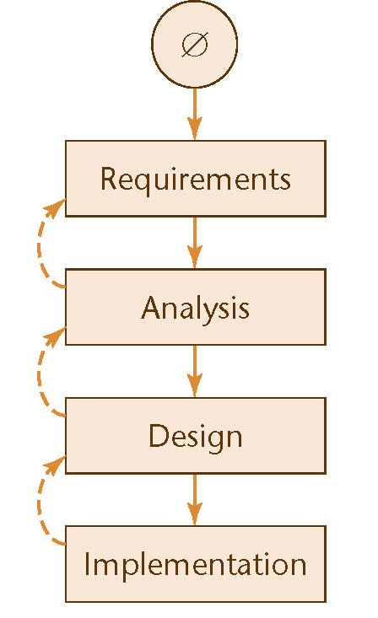
Waterfall Model
Original model of software lifecycle
Outlined steps that must happen
Project finished once shipped to client
Moves software to assembly line
Station-to-station travel of project
Model enables people to specializes
Set of deliverables created over step
Evidence & result of following process
Ends with baseline delivered to client
Contains complete set of documents

Slide 4
Waterfall Model
Original model of software lifecycle
Outlined steps that must happen
Project finished once shipped to client
Moves software to assembly line
Station-to-station travel of project
Model enables people to specializes
Set of deliverables created over step
Evidence & result of following process
Ends with baseline delivered to client
Contains complete set of documents
This means:
a) nobody likes it;
b) rarely works in real life; &
c) everybody tries improve it
d) sometimes necessary

Slide 5

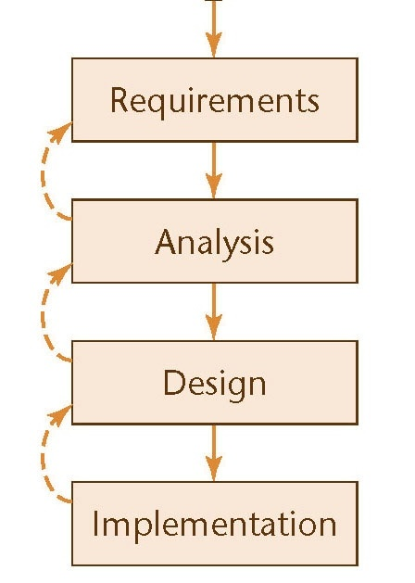
Waterfall Model
Assumes project begins as clean slate
Big Bang approach another name used
Bug fixes and maintenance not planned
Ends once coded; single pass approach
Especially now, reality rarely this clean

Slide 6

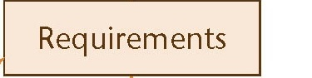
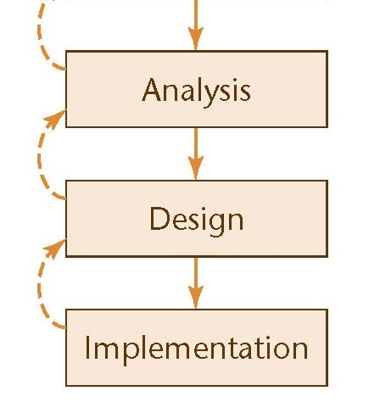
Waterfall Model
Requirements begins with meetings
Only chance for client to provide input
Working together to define project
Ends with contract specifying result
Once contract signed, client goes away
No further interaction until delivery

Slide 7
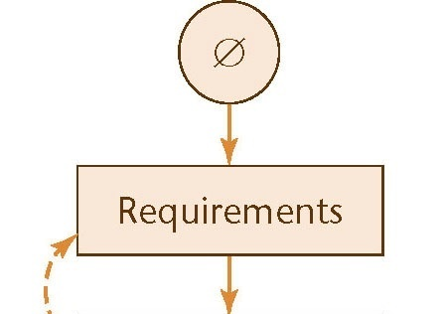

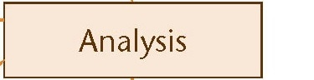
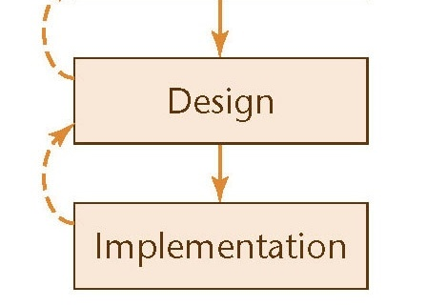
Waterfall Model
Requirements begins with meetings
Results specified in contract at end
Analysts use contract to develop ideas
Create models, schema, business logic
But starts with check of contract
Looking for inconsistencies or ambiguities
Very limited window to flag mistakes
Hands results to the project design team

Slide 8
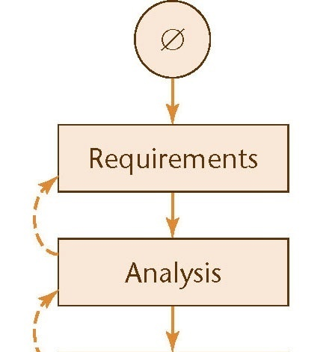
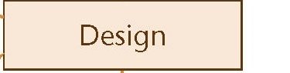
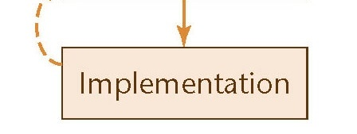
Waterfall Model
Analysts use contract to develop ideas
Create models, schema, business logic
Design outlines code to be written
Needs to specify classes & routines
Hardware & architectures also required
Has to fit existing models & schema
Algorithms often specified at this stage

Slide 9
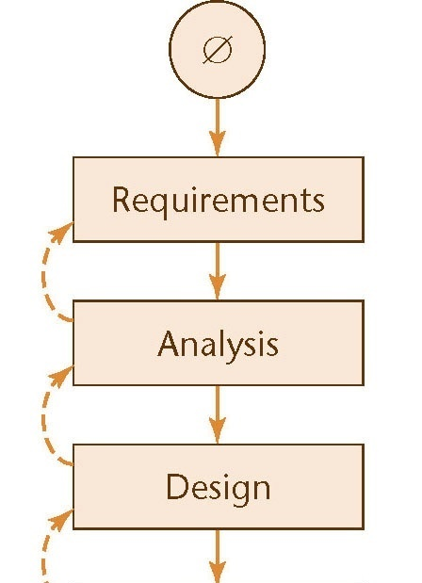
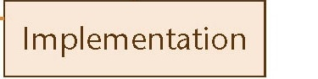
Waterfall Model
Design outlines code to be written
Needs to specify classes & routines
Implementation is for the coders
Start with time to find design problems
Then match design in code written
Only job is to match design given them
Client returns at end to take baseline

Slide 10
Waterfall Model
Extremely efficient WHEN it works
Revolutionary like Ford’s assembly line
Strengths used due to specialization
With all info, best decisions possible

Slide 11

Waterfall Model

Slide 12
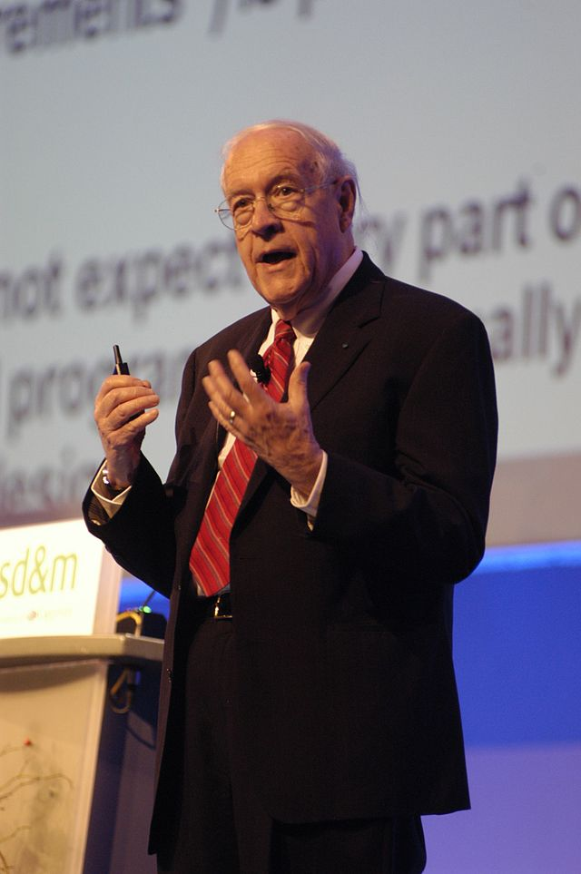
Waterfall Key Problem
Changeability is an essential difficulty with software
Waterfall assumes everything known at start
Fred Brooks

Slide 13
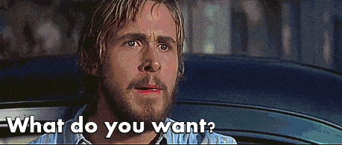
Talking To Clients

Slide 14
Waterfall Model
Useful when:
Client knows needs for their system
Needs can be fully documented & described
Little-to-no interaction sought while developed
Large organization can afford to specialists for each step
Maintenance & updates unimportant/not on the table

Slide 15
Moving Target Problem
Changes always happen during a project
Ability to react and incorporate change important, but…
…disrupts flow & creates issues with completed work
Changes during process causes regression faults
Errors often in unrelated portion of project
These changes become major pain to fix
Restart eventually needed as fixes get more complex
Advertised as "overhauled engine" & "major speedup"

Slide 16
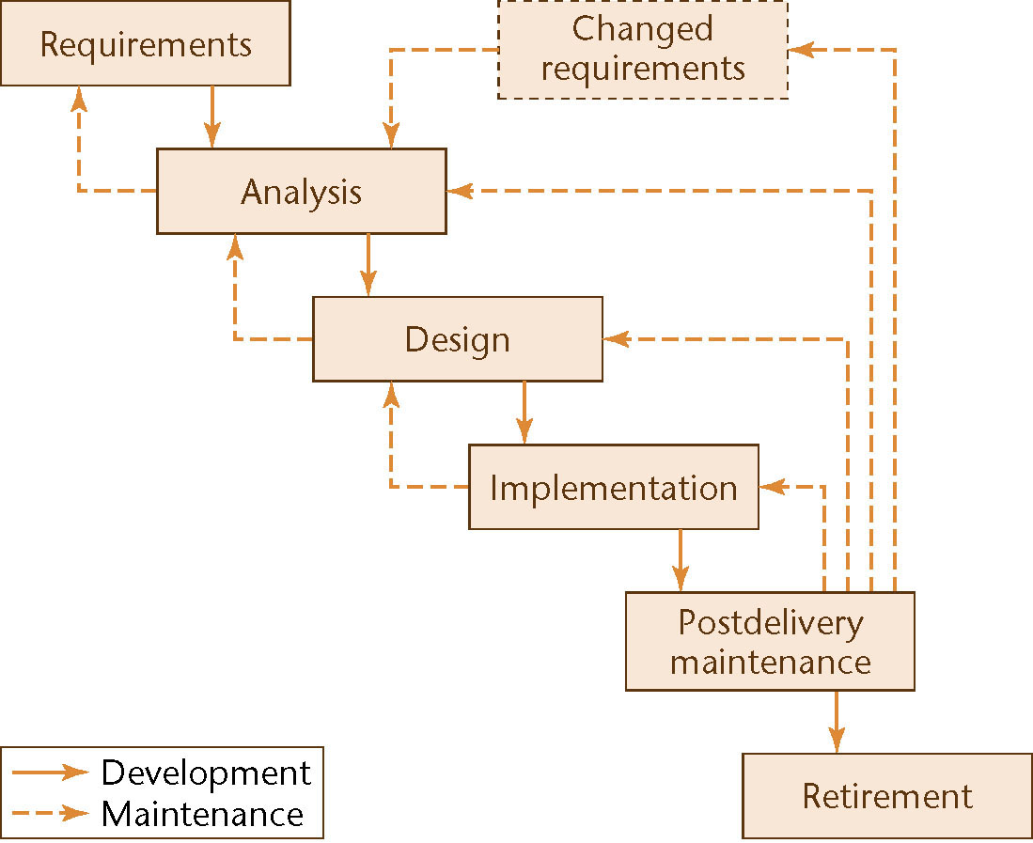
Rapid Prototyping
Create prototype after each step
to check requirements

Slide 17
Rapid Prototyping
Usability and looks are focus for rapid prototype
Provides limited ability for client to provide feedback
Functionality limited to basics (and often faked)
Any restarts take pieces back through full waterfall
Project feasibility unclear, since functionality left to end
Led to creation of VisualBasic & XCode's iOS setup
Lightweight tools emphasizing look-and-feel of app
Lousy languages with serious performance issues
Confusion possible when clients “see” finished product

Slide 18
Waterfall v Rapid Prototype
Notes:
Image of cascading waterfall used under a CC BY-NC 2.0 license. The original image was taken by Cameron Wears and is available at: https://www.flickr.com/photos/camwears/28598801471

Slide 19
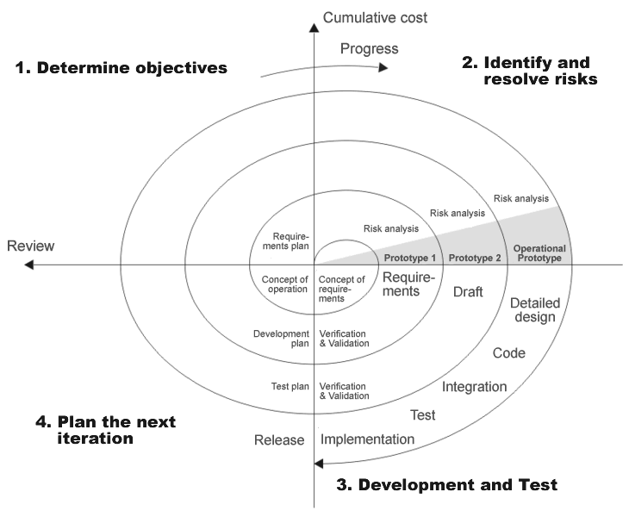
Spiral Lifecycle

Slide 20
Spiral Lifecycle
Useful for projects with unknown levels of risk
Functionality & feasibility key as opposed to looks
Uses waterfall ideas, but more cautious in execution
Each phase ends with estimate for client to review
If client like results and accepts risks, work continues
But okay to kill project when risks deemed too high
Very useful for exploratory or experimental work
Starts small and grows with time and confidence
Also can cause problems, since growth brings own risks

Slide 21
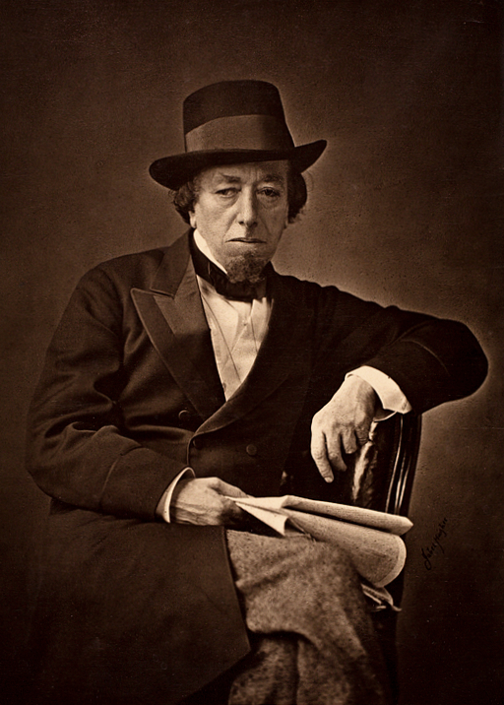
Changes
Change is inevitable
Change is constant
Benjamin Disraeli
Notes:
Image is in public domain. Original available at: https://upload.wikimedia.org/wikipedia/commons/0/0c/Benjamin_Disraeli_by_Cornelius_Jabez_Hughes%2C_1878.jpg

Slide 22
Iterative Development
Improves waterfall by working incrementally
Select most important piece needed at this moment
Follow complete waterfall to develop that ONE piece
Select new most important piece in new system
This approach also called stepwise refinement
Parallel development okay if multiple groups exist
Pieces integrated (merged) as each is completed
Quick reactions & less duplication goal of approach
But can increase costs: more regression testing needed

Slide 23
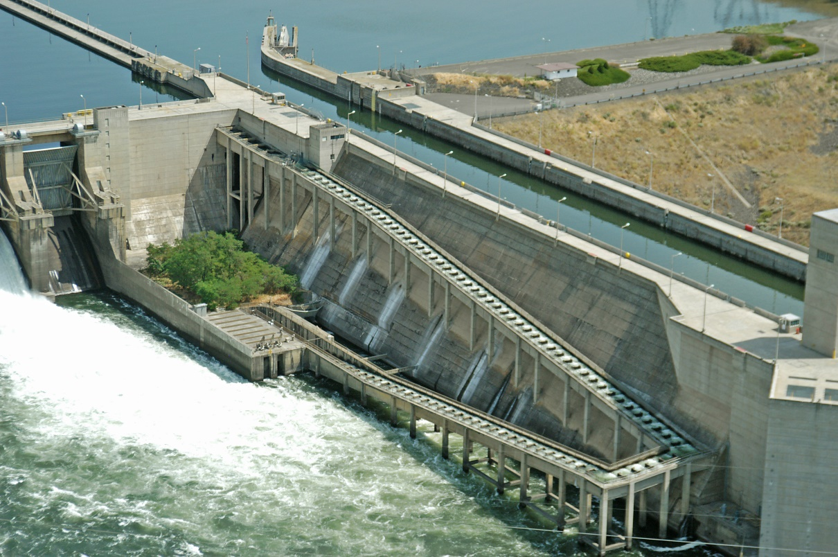
Waterfall vs. Iterative
Notes:
Salmon Ladder picture used under Creative Commons Attributions License by salmonrecovery. Original available at: https://www.flickr.com/photos/60161247@N03/11954495315/sizes/o/

Slide 24
Agile Methods
Grows out of iterative development processes
Assumes that change is inevitable & unpredictable
Planning irrational: only immediate future knowable
Series of short sprints replaces entire waterfall model
Think about the project & select most important tasks
Write acceptance tests to know when tasks complete
Do just enough coding to pass tests (& unit tests)
Design emerges by as code adjusted (refactored)

Slide 25
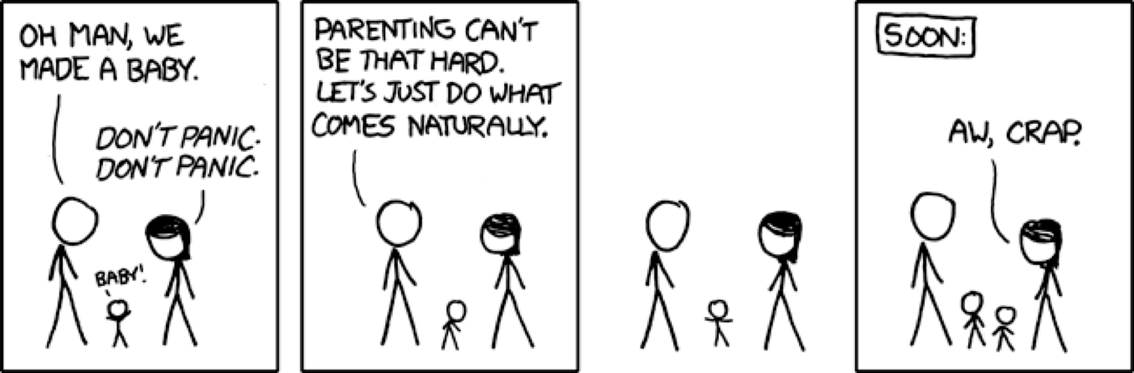
Agile Development
Not engineers, but coders: do what comes naturally

Slide 26
Agile Development
Not engineers, but coders: do what comes naturally
Other options too difficult, so let’s give up entirely!
Not always the best idea, but since we sucked before…

Slide 27
Agile Development
Not engineers, but coders: do what comes naturally
Other options too difficult, so let’s give up entirely!
Not always the best idea, but since we sucked before…

Slide 28
Agile Manifesto
[U]ncovering better ways of developing software... [W]e have come to value:
Individuals and interactions over processes and tools Working software over comprehensive documentation Customer collaboration over contract negotiation Responding to change over following a plan
[T]here is value in the items on the right, we value the items on the left more

Slide 29
Agile Principles
Deliver valuable software early and often
Each time a sprint ends: release running program
Keep sprints short: 2 – 6 weeks standard practice
Welcome changing requirements
Even late in the development process
Standardize on simple, cheap requirement practice
Few requirements per sprint, since sprints short
Keep & update backlog of requirements for later

Slide 30
Agile Principles (cont.)
We follow these principles:
Business people & developers must work together daily...
Build projects around motivated individuals
Give them the environment and support they need
Trust them to get the job done. Within development team embed product owner Eliminate other specializations* creating separations Limit management & trust what coders do naturally

Slide 31
Agile Principles (cont.)
We follow these principles:
Communicate face-to-face
Written over long weekend: February 11-13, 2001
Notes:
Don’t get too attached: this was 9 months before Harry Potter movie was released

Slide 32
Agile Principles (cont.)
We follow these principles:
Working software is … primary measure of progress
Rather a complete waterfall, jumps into development Documentation not valued: code is real deliverable
Agile processes promote sustainable development
[M]aintain a constant pace indefinitely
No overtime at crunch time
Continuous attention to technical excellence & good design enhances agility
Developers always able to refactor code to improve it

Slide 33
Agile Principles (cont.)
We follow these principles:
Simplicity -- the art of maximizing the amount of work not done -- is essential
“You Ain’t Gonna Need It” important to keep in mind
The best architectures, requirements, and designs emerge from self-organizing teams
Democratic teams (egoless coders) relied upon

Slide 34
Agile Principles (cont.)
We follow these principles:
At regular intervals, the team reflects on how to become more effective, then tunes and adjusts its behavior accordingly
Velocity tracked & used to improve processes

Slide 35
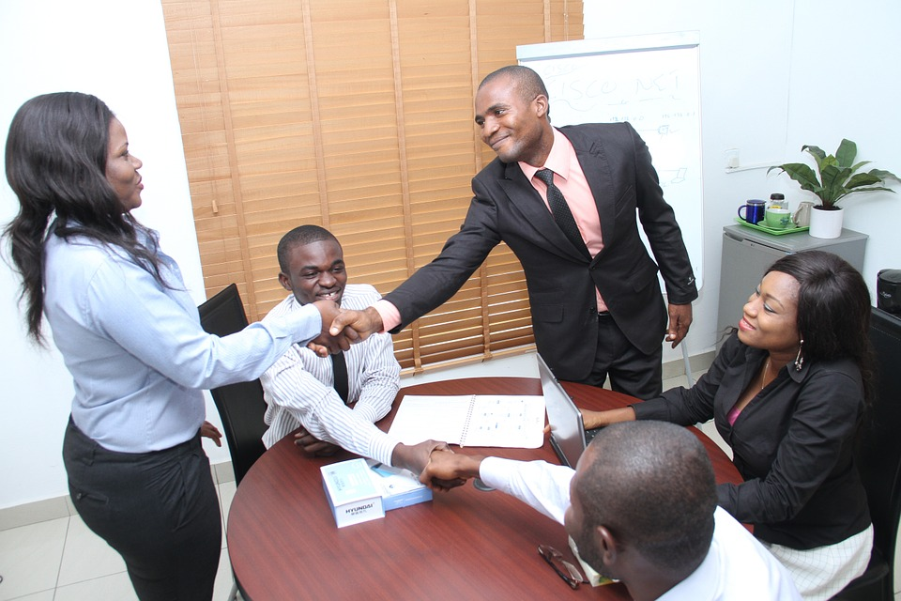
Agile Principles (cont.)
[T]eam reflects then tunes and adjusts accordingly
Most signatories ran consulting companies
Notes:
Picture is not of signatories, but is stock image entered into Public Domain by adabara. Original available at: https://pixabay.com/en/colleagues-seminar-presentation-437024/

Slide 36
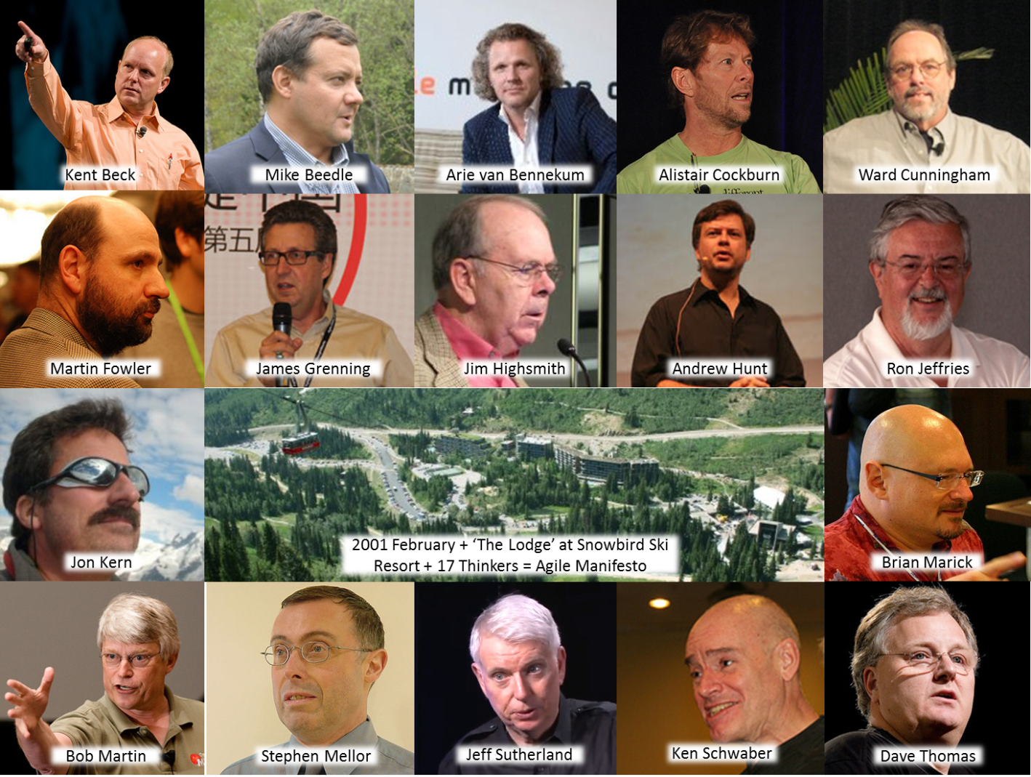
Agile Principles (cont.)
Most signatories ran consulting companies
Notes:
These are actual authors (and site!) of original Agile Manifesto

Slide 37
Agile Overview
Gather requirements
Customer: “This is what I want…”
Write & deliver code
Customer: “Okay, but it would be cool if…”
Select most important requirements from backlog
Estimate implement time so amount chosen appropriate
Write & deliver code
Customer: “This is better, but now I want…”
Repeat until customer happy

Slide 38
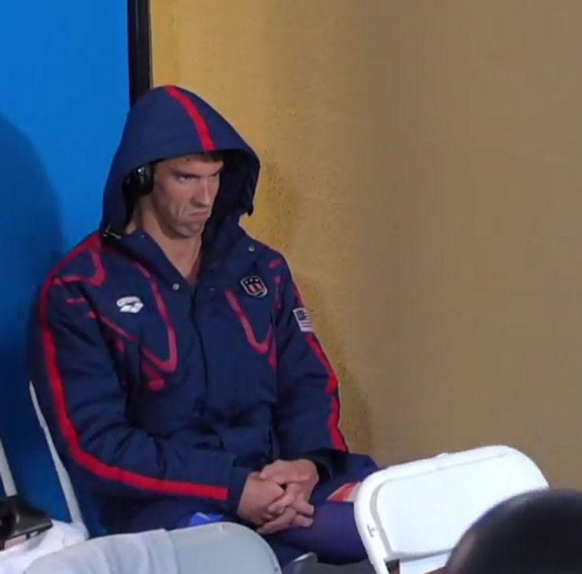
Agile Overview
Gather requirements
Customer: “This is what I want…”
Write & deliver code
Customer: “Okay, but it would be cool if…”
Select most important requirements from backlog
Estimate implement time so amount chosen appropriate
Write & deliver code
Customer: “This is better, but now I want…”
Repeat until customer happy

Slide 39
Agile Overview
Gather requirements
Customer: “This is what I want…”
Write & deliver code
Customer: “Okay, but it would be cool if…”
Select most important requirements from backlog
Estimate implement time so amount chosen appropriate
Write & deliver code
Customer: “This is better, but now I want…”
Repeat until customer happy satisfied

Slide 40
Making Agile Work: Delivery
Deliver working code at fixed SHORT intervals
Creates constant, sustainable, pace for project
Usually 1-4 weeks depending on company needs
Several tasks occur at end of every sprint
Demo the software and/or release the update
Have all-team meeting to discuss project direction
Make adjustments to “become more effective”

Slide 41
Make Agile Work: Requirements
User Stories
Lightweight approach to write & gather requirements
Have customer tell story of what they want & need
Write what comes out down without getting technical
Help YAGNI: who wants what & why do they need it?
“As a customer, I want to see the details of each piece of equipment before I add it to my cart so I know if it will be worth buying”

Slide 42
Make Agile Work: Worklist
Tasks
Breaks down stories into technical requirements
Helps focus activities by making story into concrete work
Details needed, by prevents overwhelming customer
Host a database of equipment information
Assign equipment unique IDs embedded on web pages
Write stored procedures taking in unique IDs
Display query results to the user

Slide 43
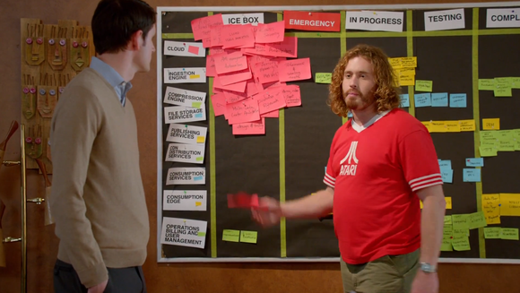
Making Agile Work: Communication
Notes:
From Silicon Valley

Slide 44
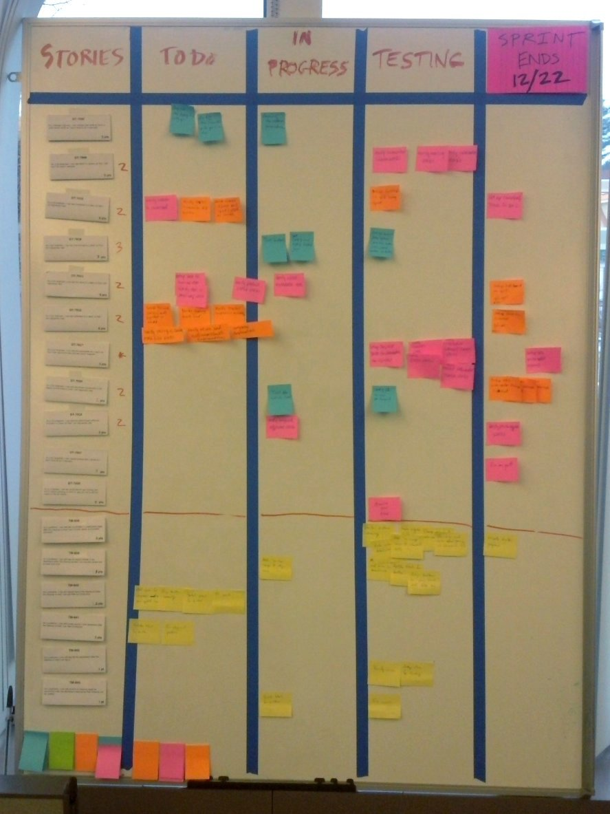
Making Agile Work: Communication

Slide 45
Making Agile Work: Communication
Work displayed in one of several possible columns:
Backlogged
In progress
Testing
Complete
Stories and tasks moved as part of daily standup
Columns not standardized, uses lingo of organization
Co-location valued: physical board considered ideal

Slide 46
Making Agile Work: Co-Location
Team members meet face-to-face to build trust
Start each day with stand-up meeting sharing progress
More flexibility occurring, can video remote workers in
Communicate constantly throughout day
Nobody “owns” code, so important to avoid conflicts
Documentation not valued & often easier to talk/Slack
Pair programming big (overlooked) feature of Agile

Slide 47
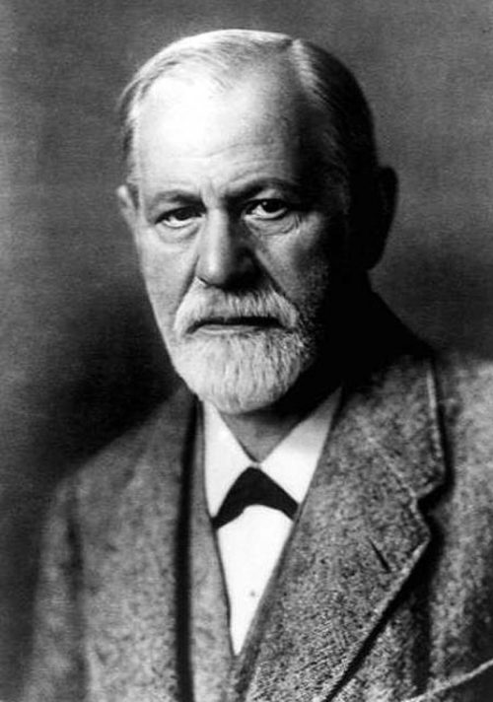
Choosing Team Organization
Exceedingly little study of team organization
Instead rely on general group dynamic research
Woo-hoo! Psychology texts to read
Software engineering use faces two big issues
Psychology texts are boring; very, very, very, very, very boring
Software engineers rarely trained in psychology

Slide 48

Choosing Team Organization
In real world, optimal approach does not exist
Depend on situation & people included on team
Organizational approach can be changed to fit people
Or change people to fit team organization
Scientifically team dynamics difficult to analyze
Hard to set-up experiments that could do this well
Trying to control these experiments may be unethical

